Slide 1
Case Studies

Slide 2

Case Study #1

Slide 3
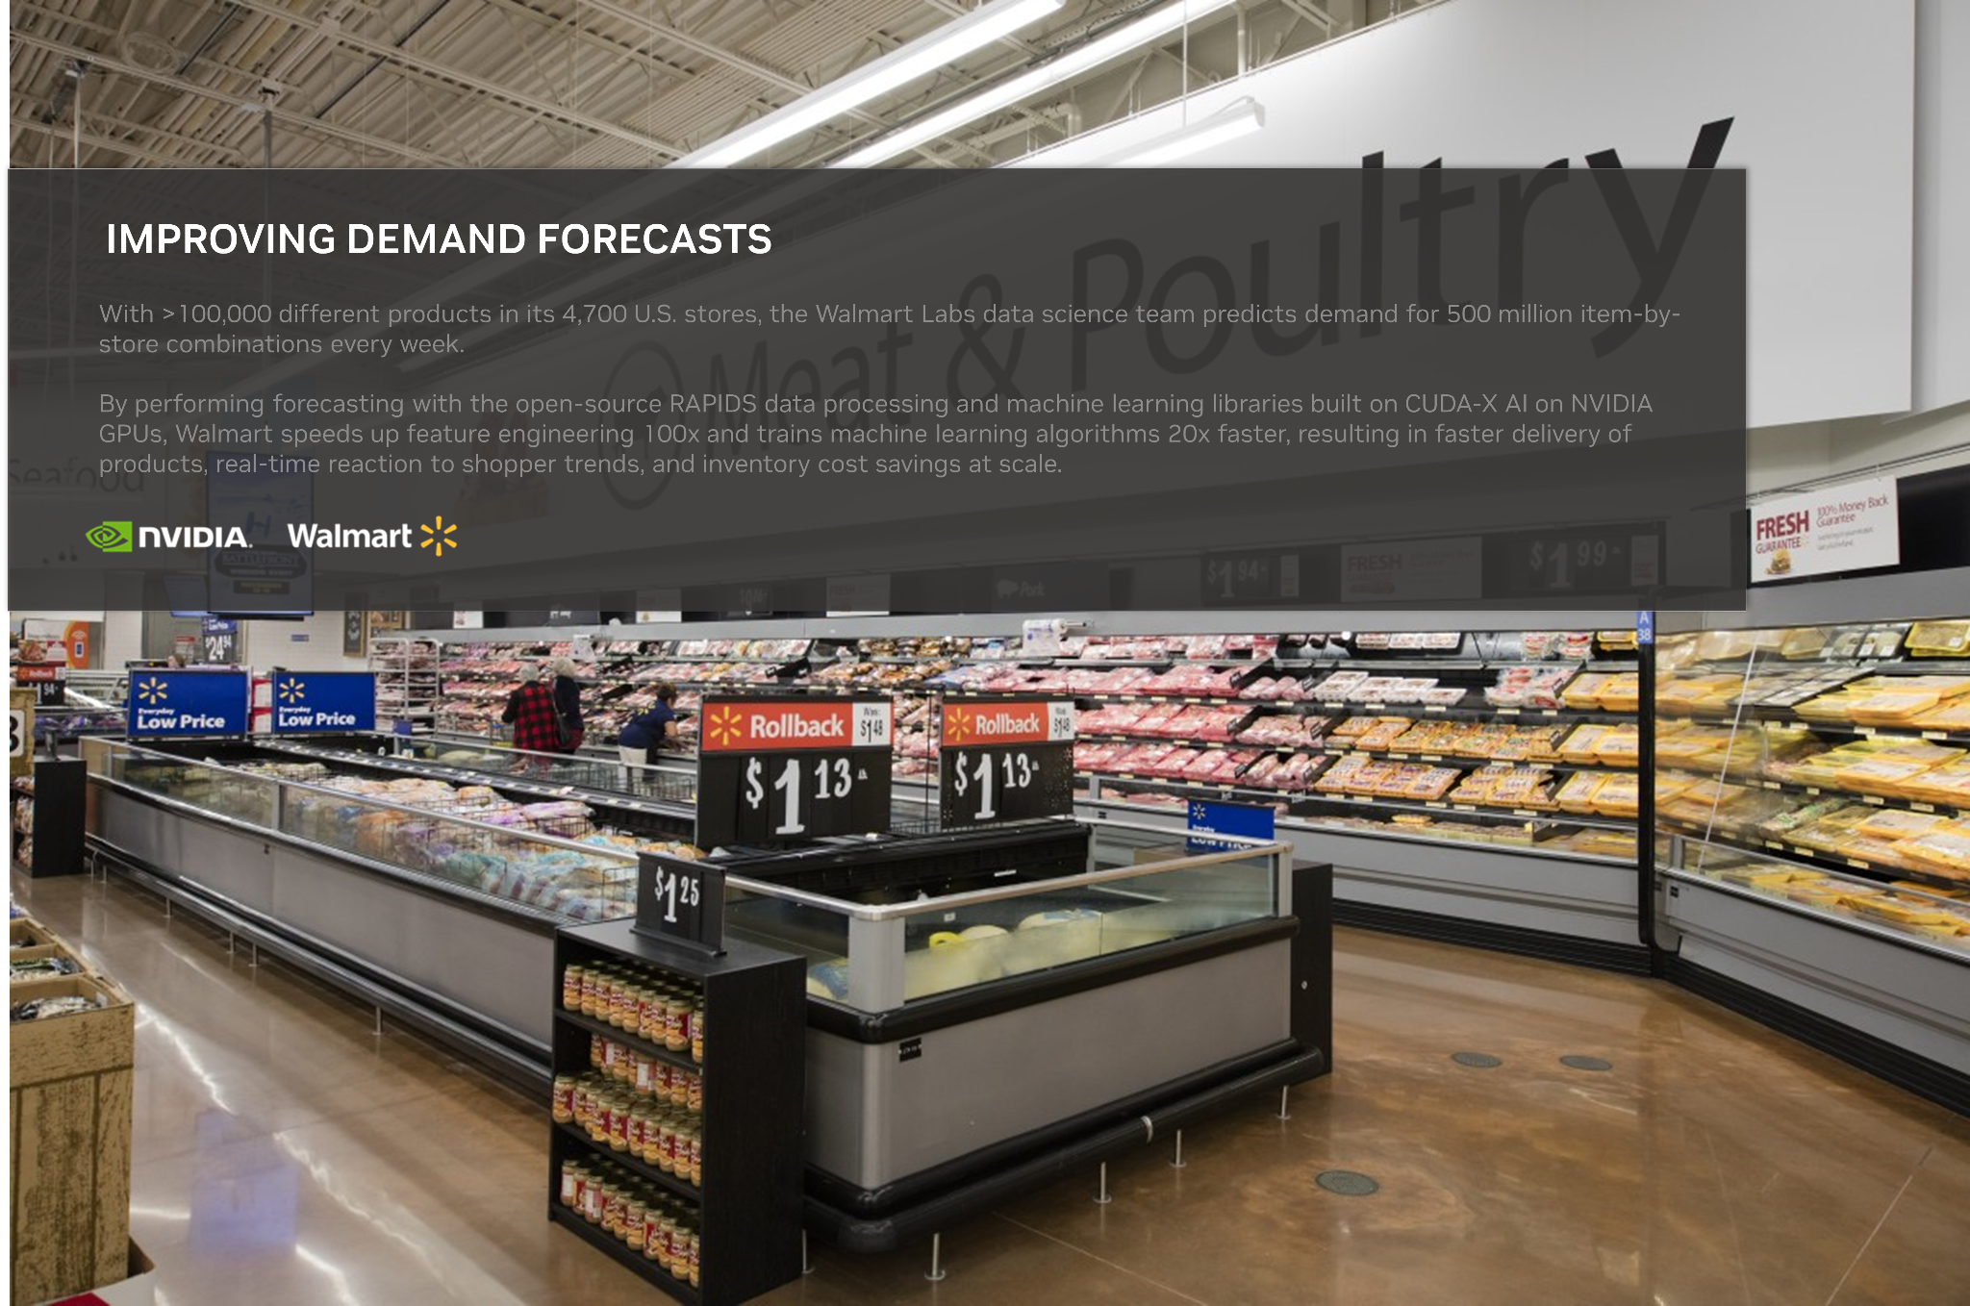
Case Study #2

Slide 4

Case Study #3

Slide 5

Case Study #4

